Slide 1


Handwriting Based Author Recognition (Research Based)
Project Supervisor : Dr. M. Mian Saleem
Co-Supervisor : Ms Hirra Mustafa
Department of Computer Science
Sharif College of Engineering & Technology, Raiwind Road, Lahore

Slide 2
Team Introduction
Adil Jabbar
2019-UET-SHCET-CS-02
Ali Hassan Mughal
2019-UET-SHCET-CS-14
Mubashir Ilyas
2019-UET-SHCET-CS-26

Slide 3
Table of Content
Introduction
Literature Review
Problem Statement
Objective
Model Formulation
Actual Data
Preprocessed and Augmented Data
Testing & Analysis
Conclusions
References

Slide 4
Introduction
Recognize the Author of a sample handwritten document, from a set authors.
Recent advances in artificial intelligence (AI), image processing, data mining, pattern recognition and machine learning have shown that it is possible to automate author identification.
Features are extracted by using scanned images of handwritten words and trained using SVM algorithm.

Slide 5
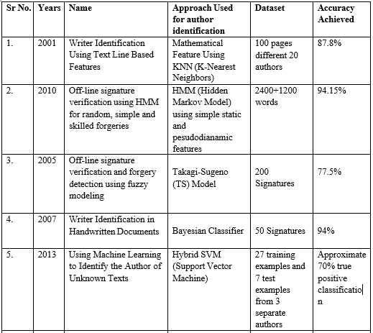
Literature Review

Slide 6
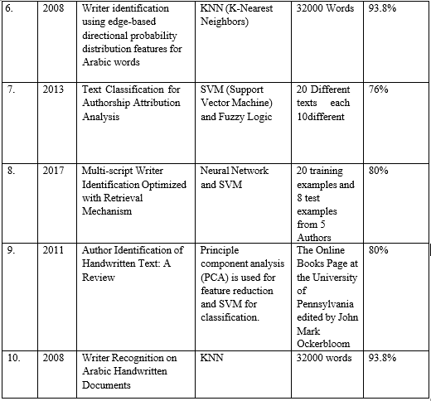
Literature Review

Slide 7
Problem Statement
Current methods for author recognition, such as manual analysis and signature verification, are time-consuming and error-prone.
The need for more efficient and accurate method for author recognition is important in application such as banking, document verification.
Handwriting-based author recognition is challenging due to variations in handwriting styles among individuals.

Slide 8
Objective
Identify existing research and methods in the field of handwriting-based author identification.
Evaluate the effectiveness of current methods and identify their limitations
Collect and preprocess a dataset of handwriting samples from different authors.
Identify potential applications and areas of improvement for the developed system.

Slide 9
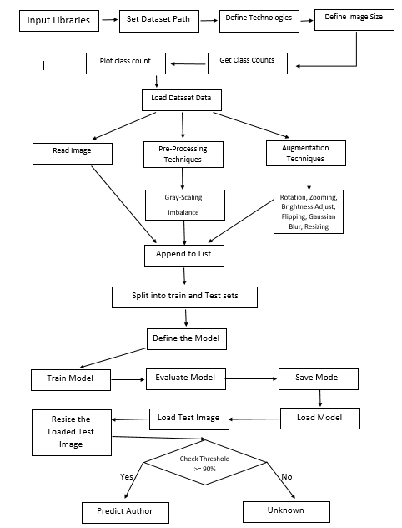
Model Formulation
The model formulation of our project
has following steps:
Steps
Data collection
Feature extraction
Feature selection
Model training
Model evaluation
Model optimization
Deployment

Slide 10
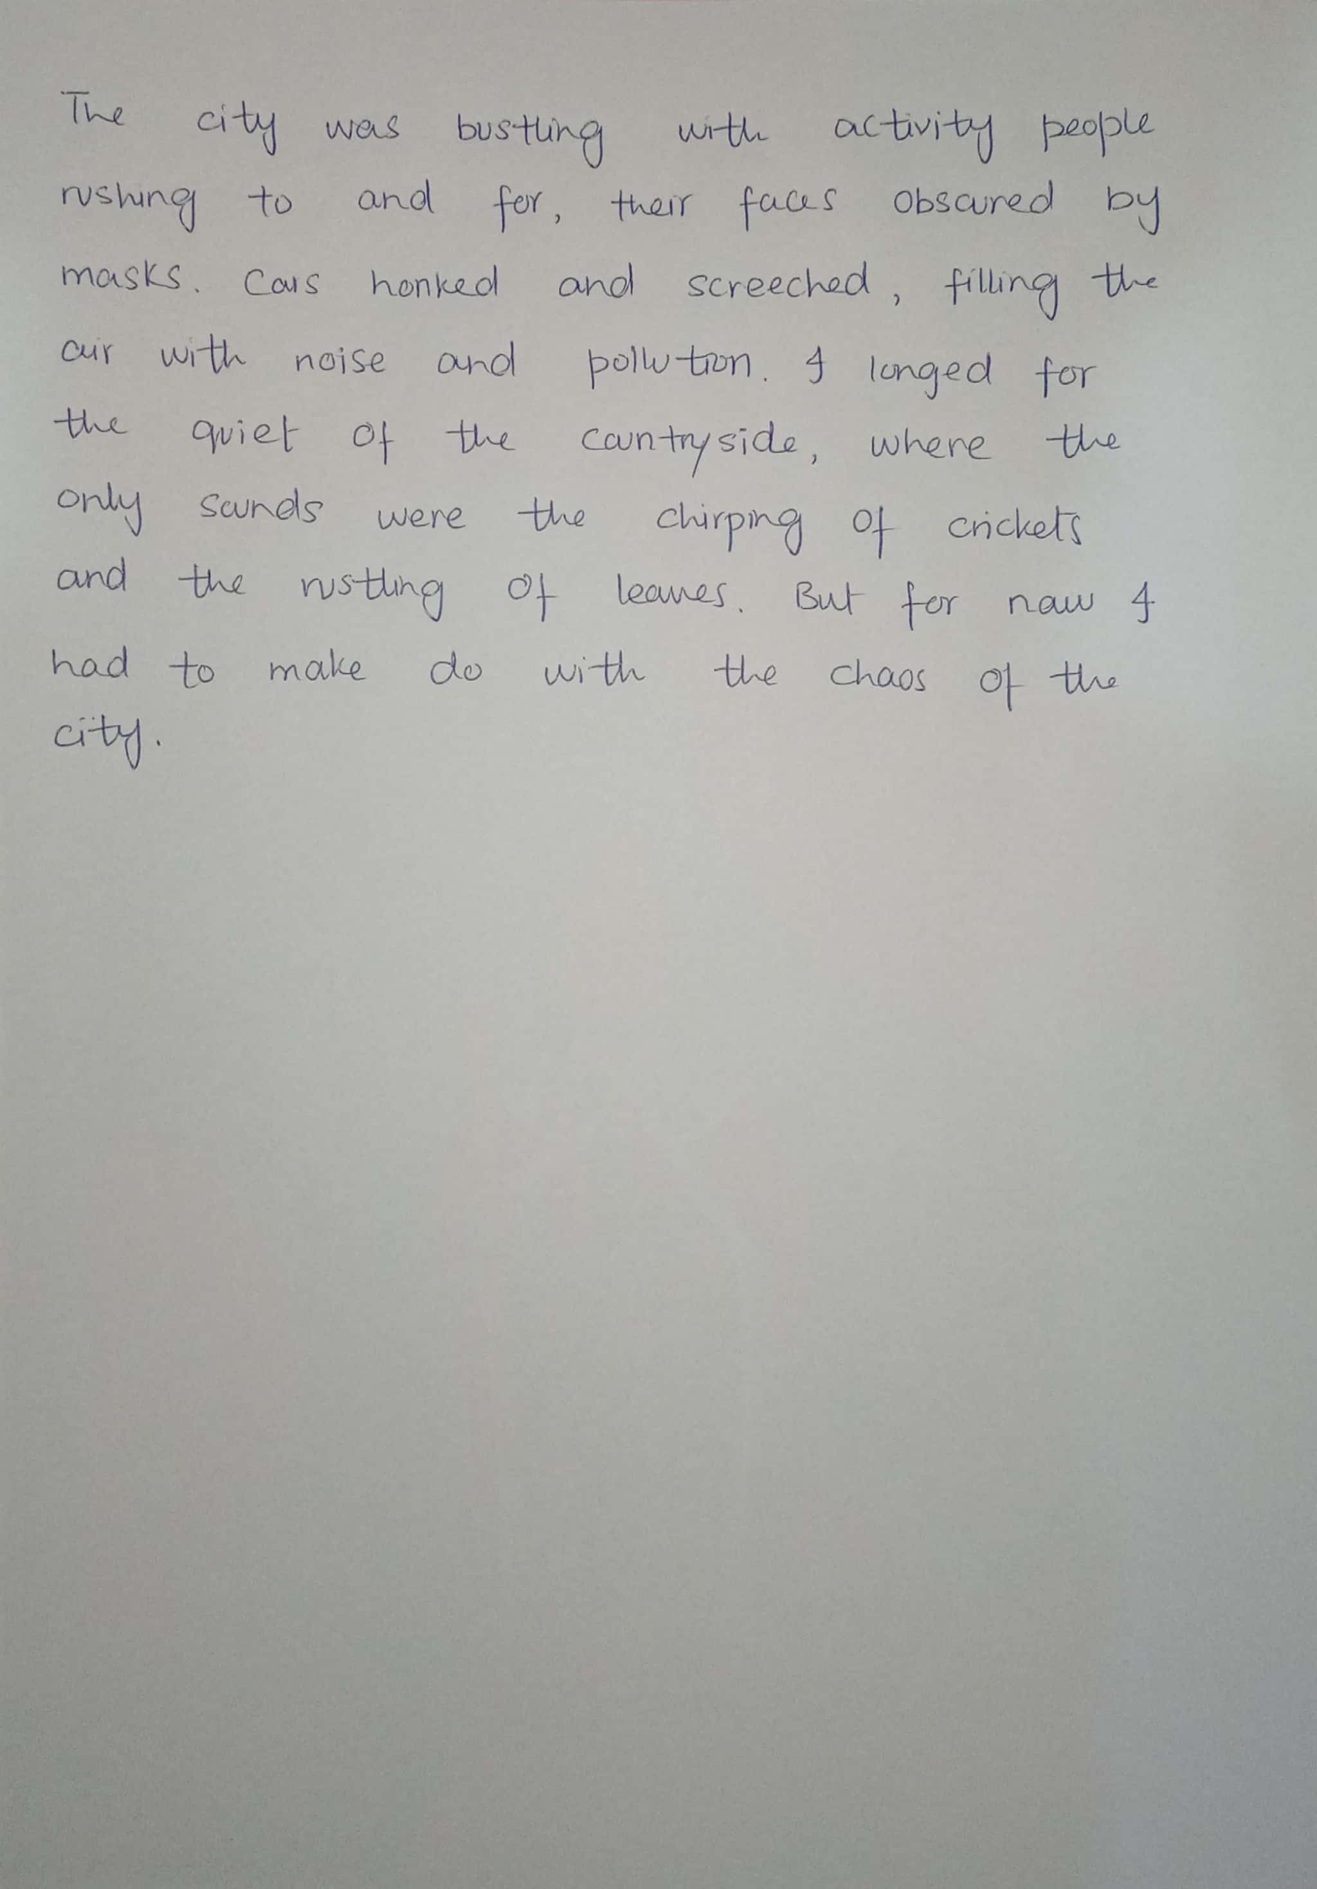
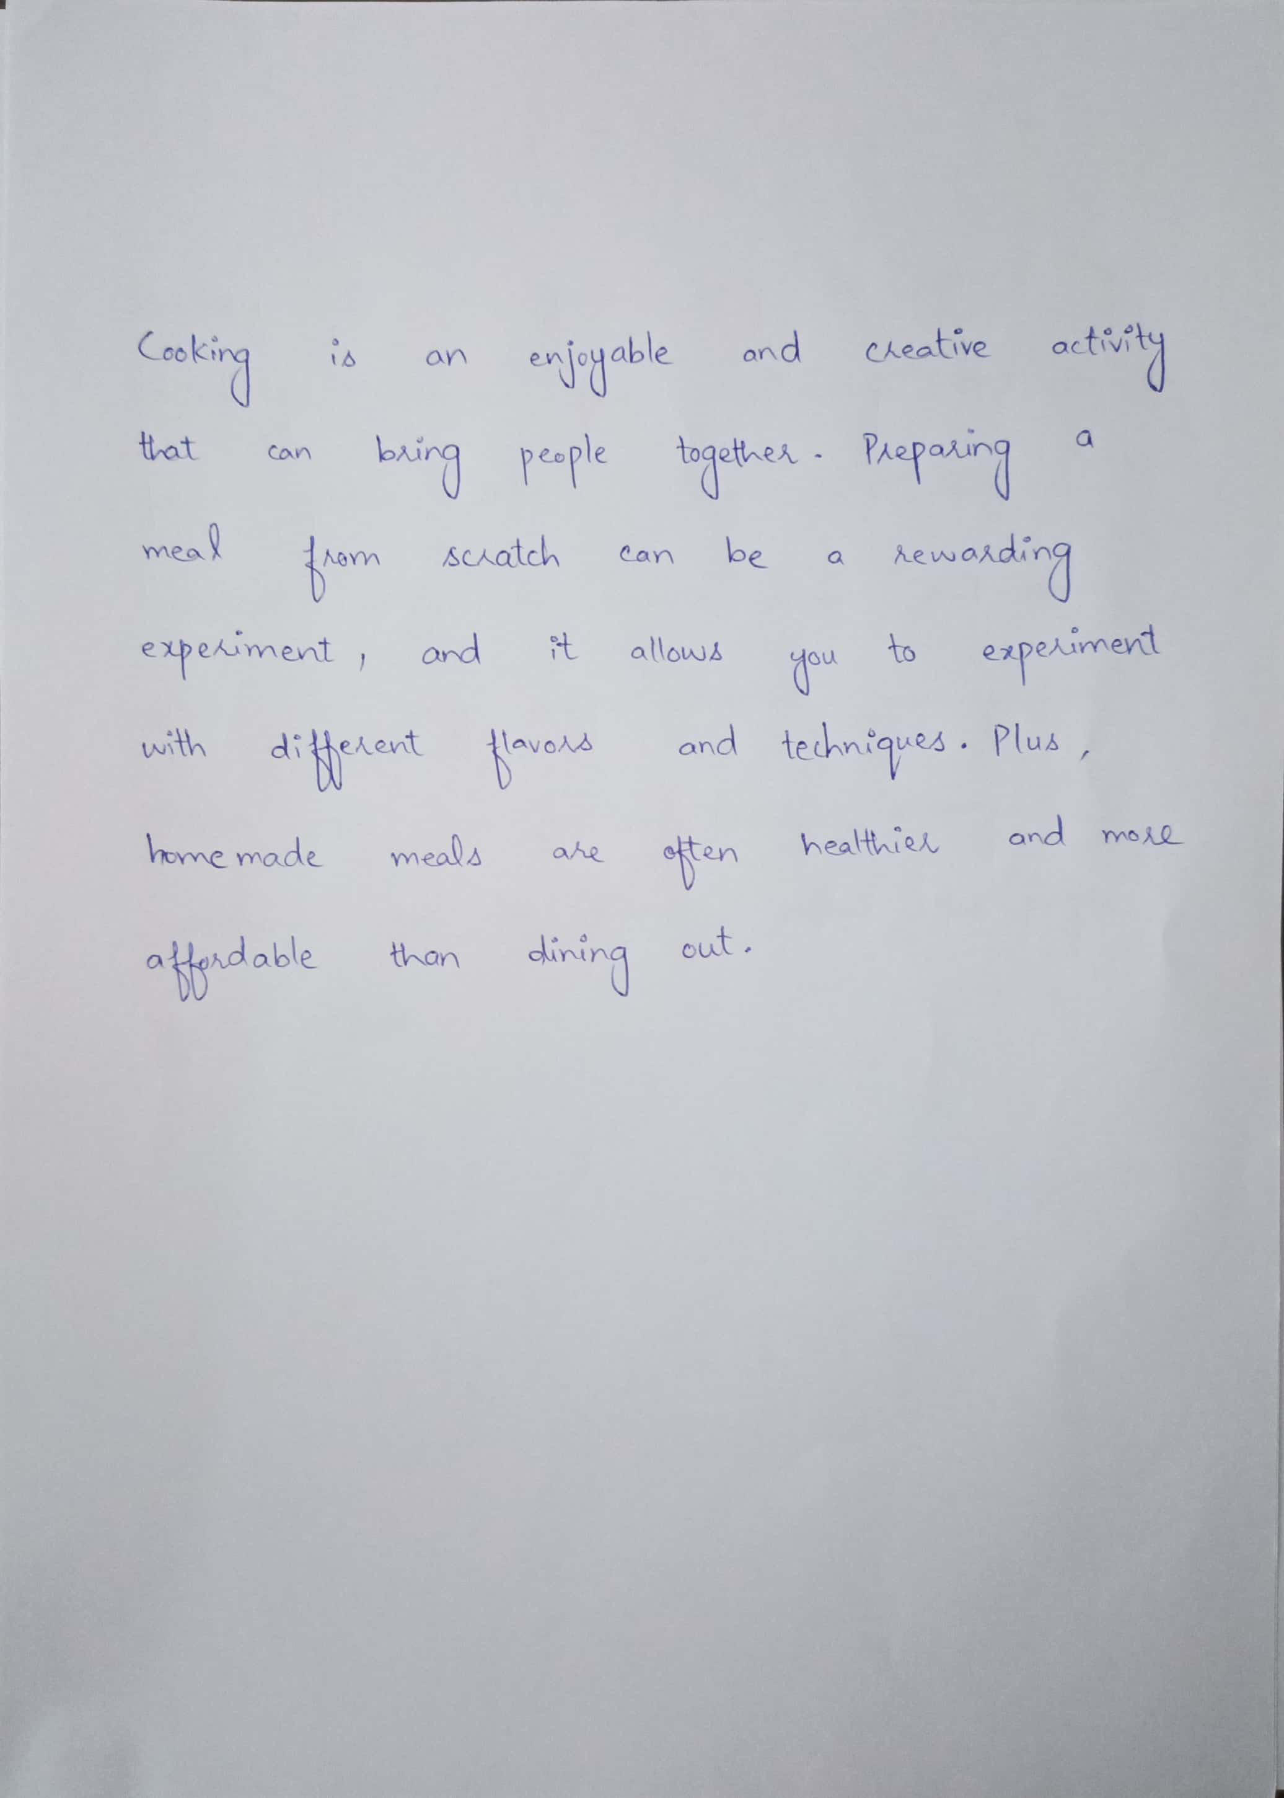
Actual Data
Dataset of Two different Authors

Slide 11
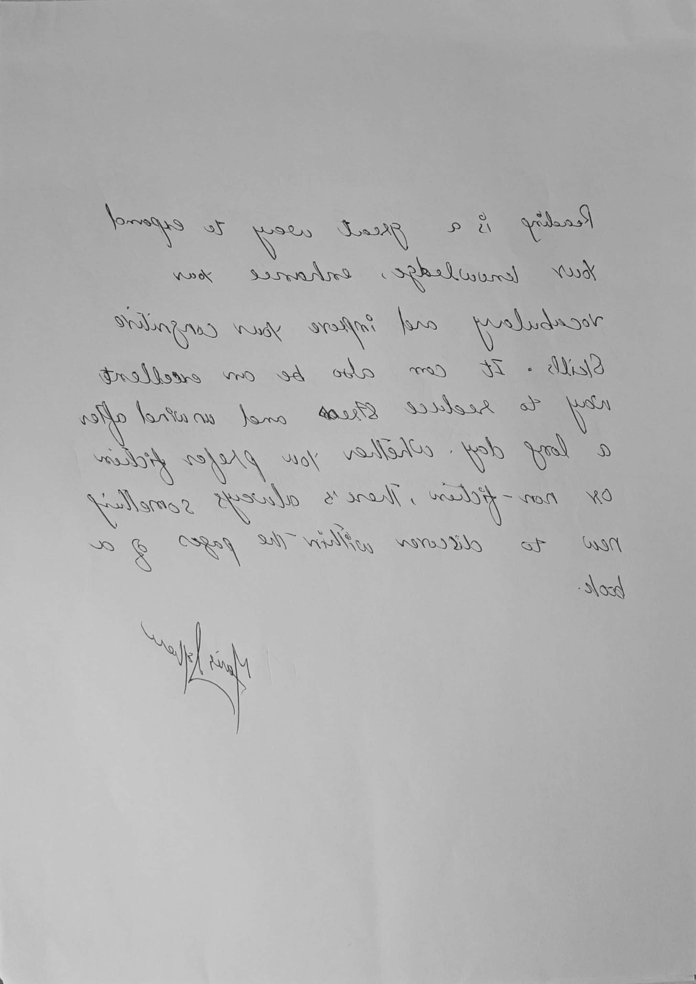
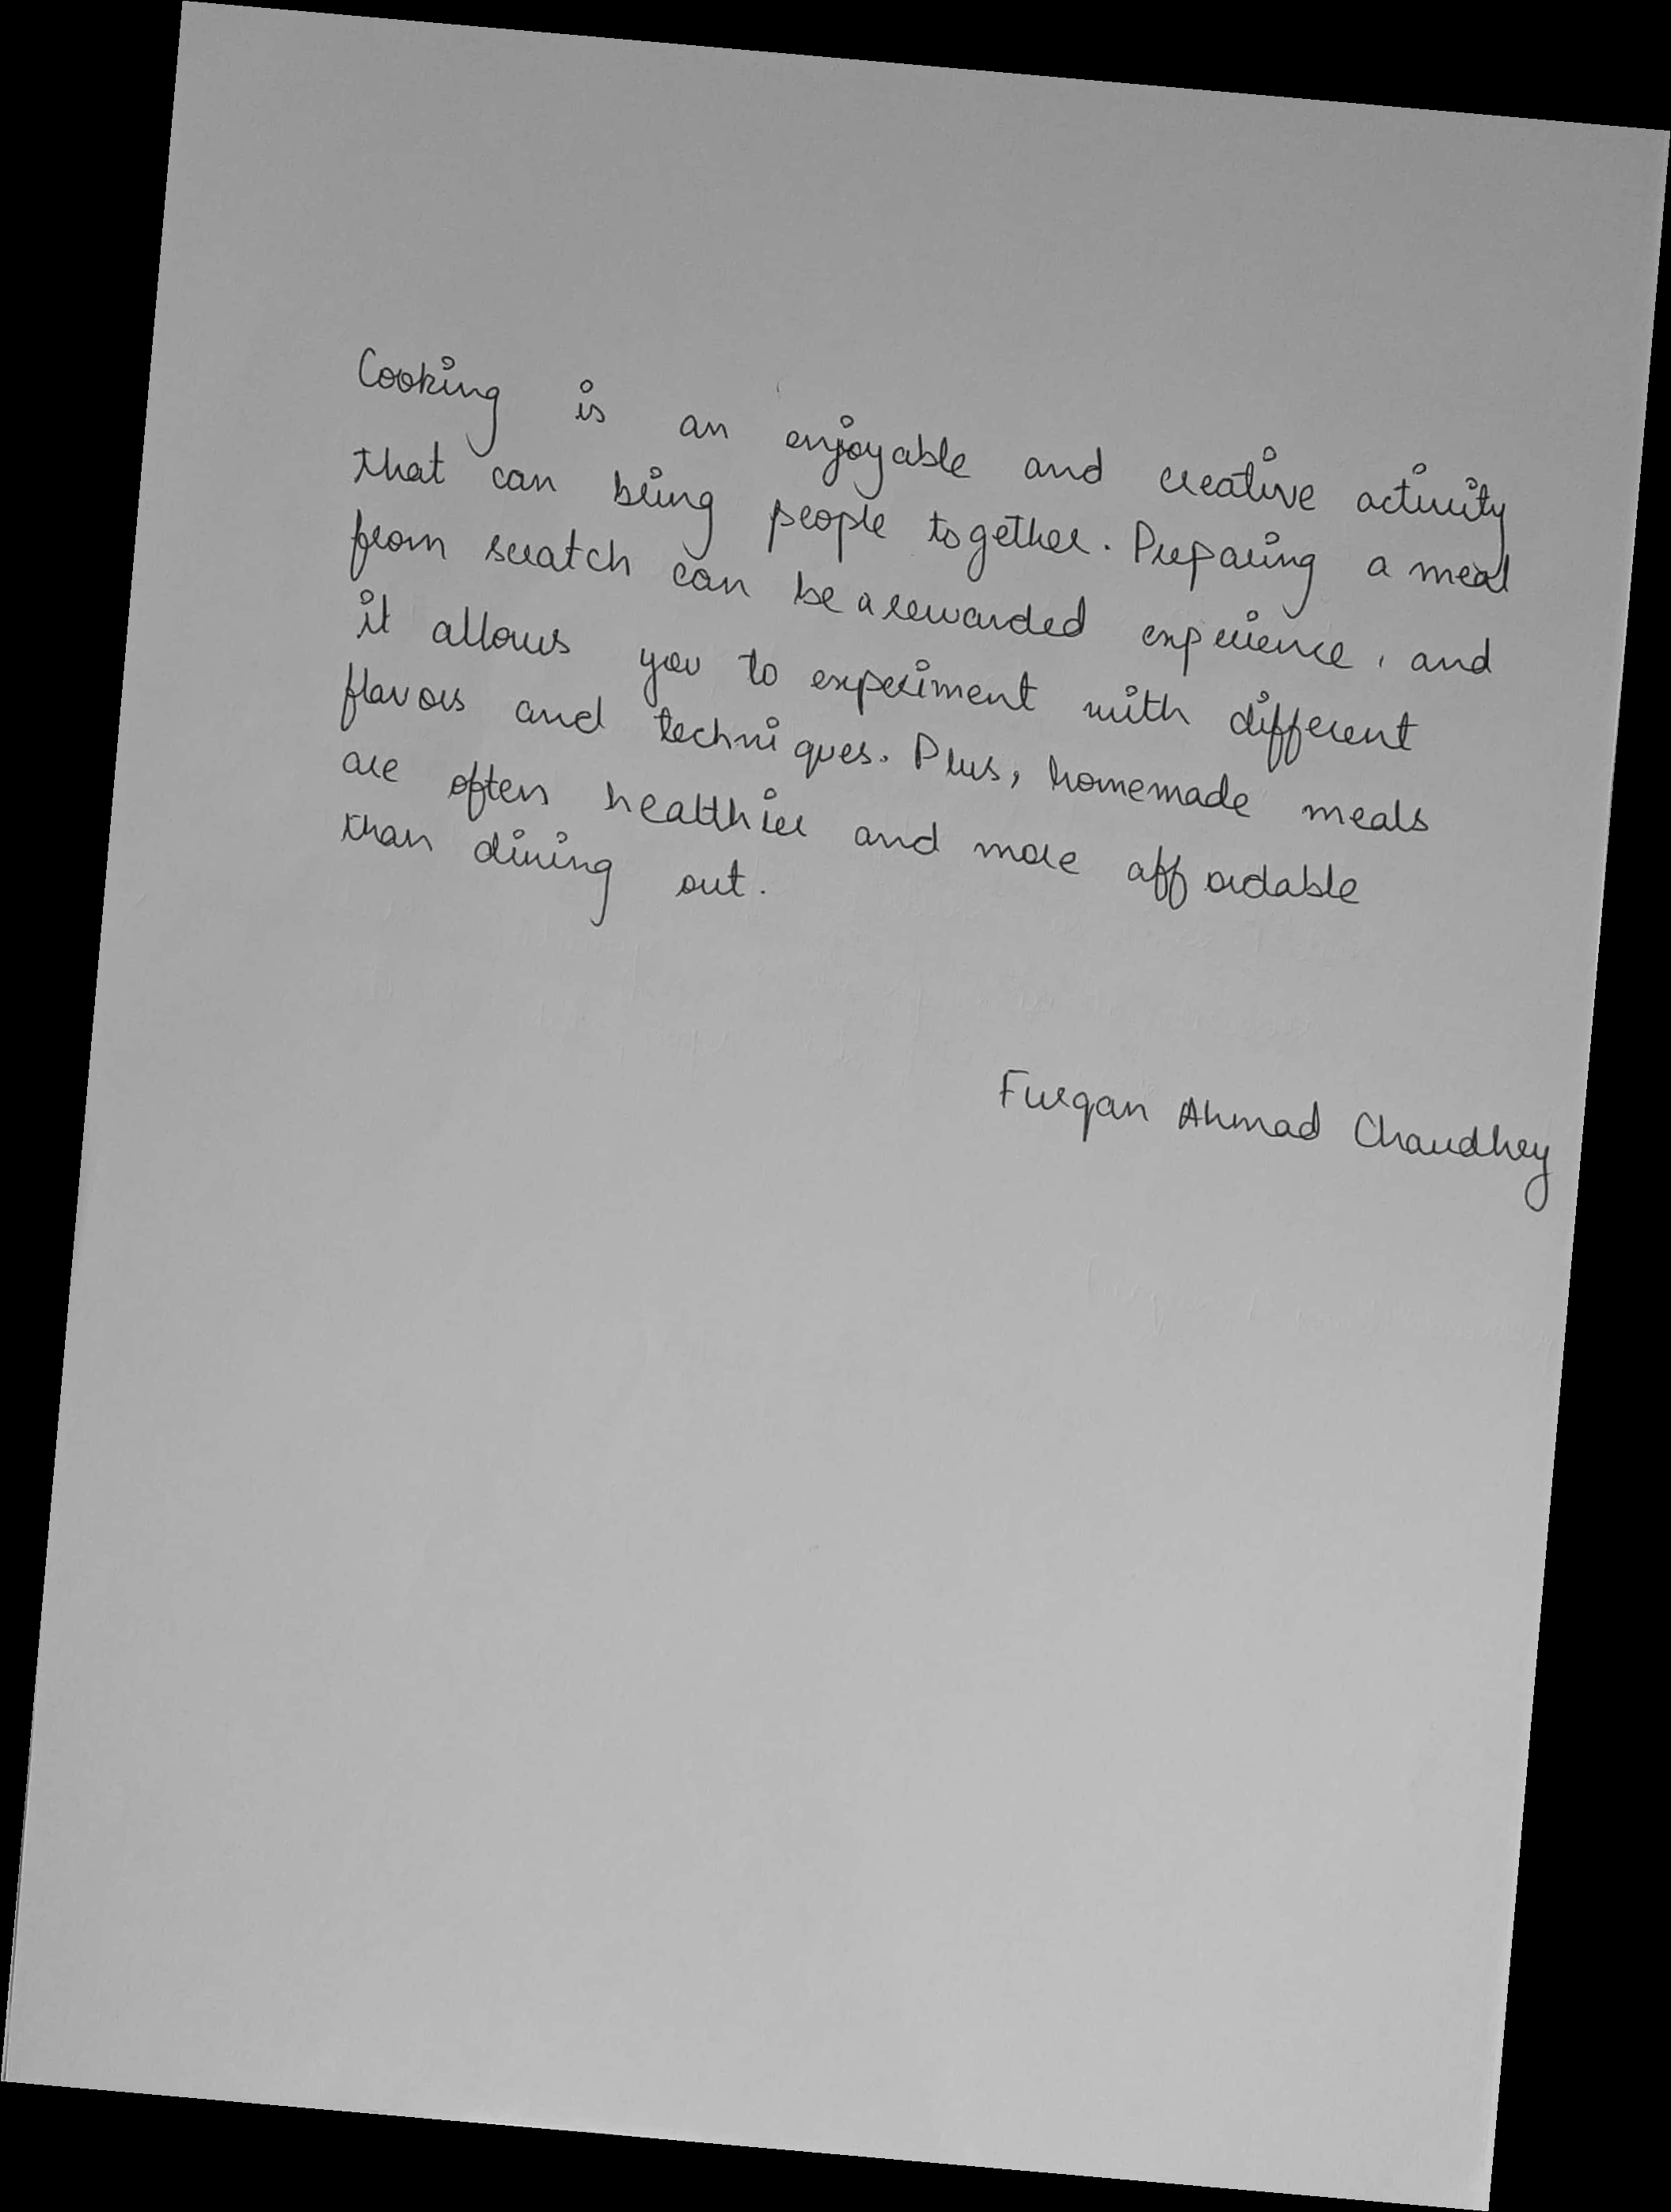
Preprocessed and Augmented Data
Dataset of Two different Authors

Slide 12
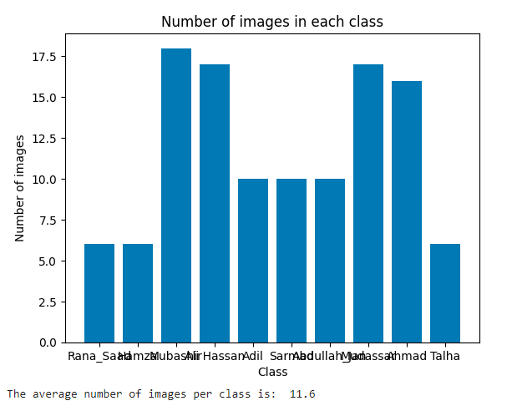
Testing & Analysis
Training accuracy: 0.753
Testing accuracy: 0.428

Slide 13
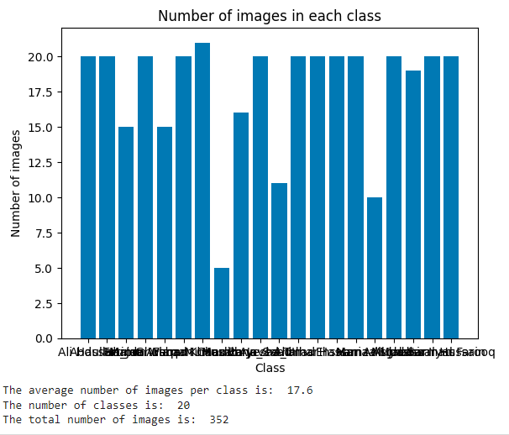
Testing & Analysis
Training accuracy: 0.979
Testing accuracy: 0.915

Slide 14
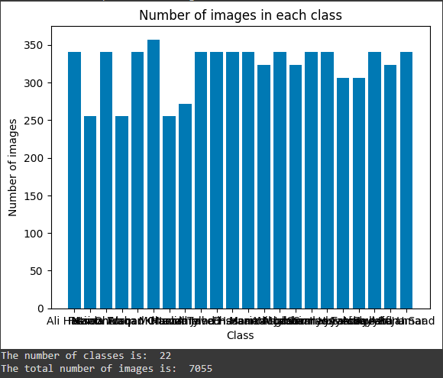
Testing & Analysis
Training accuracy: 0.986
Testing accuracy: 0.968

Slide 15
Conclusion
The proposed handwriting author identification method using SVM and image processing techniques demonstrated its feasibility and accuracy. The achieved testing accuracy of 96.81% indicates that the model can accurately identify the author of a given handwritten document, which has practical applications in fields such as banking, insurance company, and handwriting recognition. The preprocessed and augmented data was loaded the images were resized to 100x100 pixels The model was trained on a dataset consisting of 22 authors and 7,055 images, achieving a training accuracy of 0.986 and a testing accuracy of 0.968. Overall, this system can be utilized for various applications, including banking and document verification.

Slide 16
Reference
[1] Kırlı, Ö., & Gülmezoğlu, M. B. (2012). Automatic writer identification from text line images. International Journal on Document Analysis and Recognition (IJDAR), 15(2), 85-99.
[2] Shen, C., Ruan, X. G., & Mao, T. L. (2002, June). Writer identification using Gabor wavelet. In Proceedings of the 4th World Congress on Intelligent Control and Automation (Cat. No. 02EX527) (Vol. 3, pp. 2061-2064). IEEE.
[3] Griswold-Steiner, I., Matovu, R., & Serwadda, A. (2017, October). Handwriting watcher: A mechanism for smartwatch-driven handwriting authentication. In 2017 IEEE International Joint Conference on Biometrics (IJCB) (pp. 216-224). IEEE.
[4] Gilewski, J., Philips, P., Yanushkevich, S., & Popel, D. (1997). Education Aspects: Handwriting Recognition-Neural Networks-Fuzzy Logic. In Proceedings of the IAPR International Conference on Pattern Recognition and Information Processing–PRIP (Vol. 97, pp. 39-47).
[5] Van Der Maaten, L., & Postma, E. O. (2005, August). Improving automatic writer identification. In BNAIC (pp. 260-266).
[6] Tan, G. J., Sulong, G., & Rahim, M. S. M. (2017). Writer identification: a comparative study across three world major languages. Forensic science international, 279, 41-52.
[7] Griswold-Steiner, I., Matovu, R., & Serwadda, A. (2019). Wearables-driven freeform handwriting authentication. IEEE Transactions on Biometrics, Behavior, and Identity Science, 1(3), 152-164.
[8] Marti, U. V., & Bunke, H. (2000, September). Handwritten sentence recognition. In Proceedings 15th International Conference on Pattern Recognition. ICPR-2000 (Vol. 3, pp. 463-466). IEEE.

Slide 17


